Slide 1
2244 Arçelik-ODTU Industrial Servo Drive – Autotuning
03.04.2020 Online meeting
Review Article - Setup

Slide 2
Previously on meetings
Literature review
Mechanical setups
T type filter
Sweep response analysis

Slide 3
Project Map
Literature
Problem
Building Model
Building Test Bench
Evaluating prior art solutions
Trails
Thesis

Slide 4
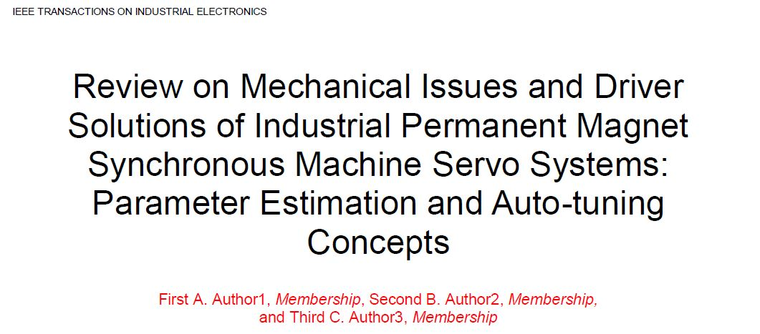
Review Article

Slide 5
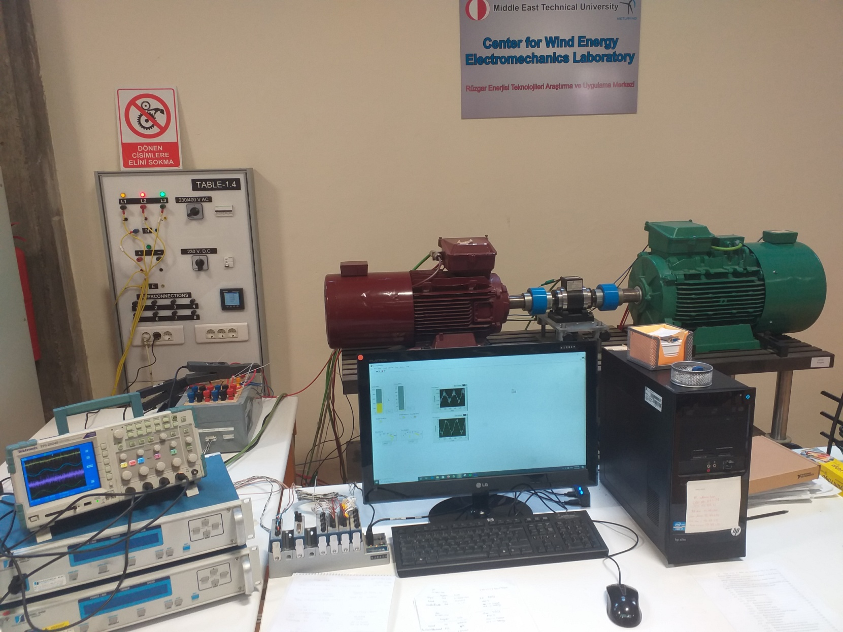
Experimental Setup - RÜZGEM
IM Torque mode
Open loop
PM SG Speed mode
Switching
Labview

Slide 6
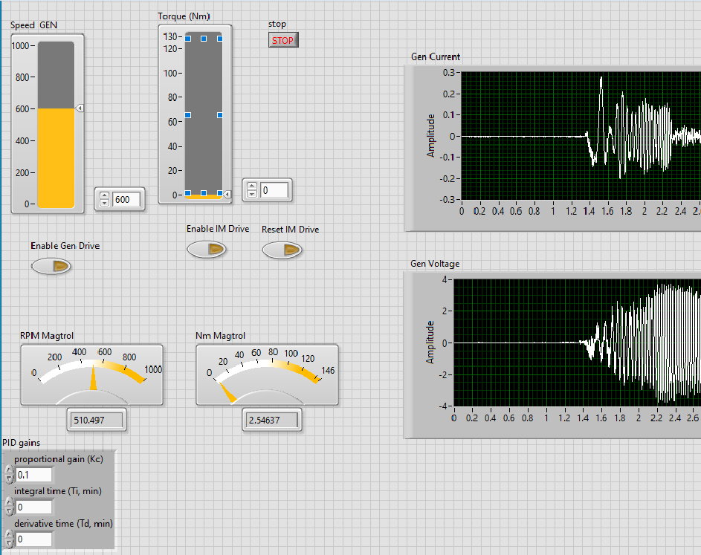
User interface on RÜZGEM setup

Slide 7
Measurements set 1
Zero speed – Zero torque :
System electrical noise
Constant speed – Zero torque :
elec + PMSM mech noise
Constant speed – Constant torque :
elec + PMSM mech + IM mech noise

Slide 8
Measurements set 2
Startings :
@ zero torque – constant speed
@ constant torque – constant speed
Speeds are selected as 600 rpms and 800 rpms.
Torques are 30Nm and 40Nm (max. Torque of
setup 140Nm)

Slide 9
Measurements set 3
Scenarios :
starting @ constant speed, 3 sec later 2Nm torque pulse.
@ constant speed, periodic 2Nm torque pulses
@ constant speed, mechanical disturbance on the shaft (with a rigid object)
@ constant torque, 10 rpm speed changes

Slide 10
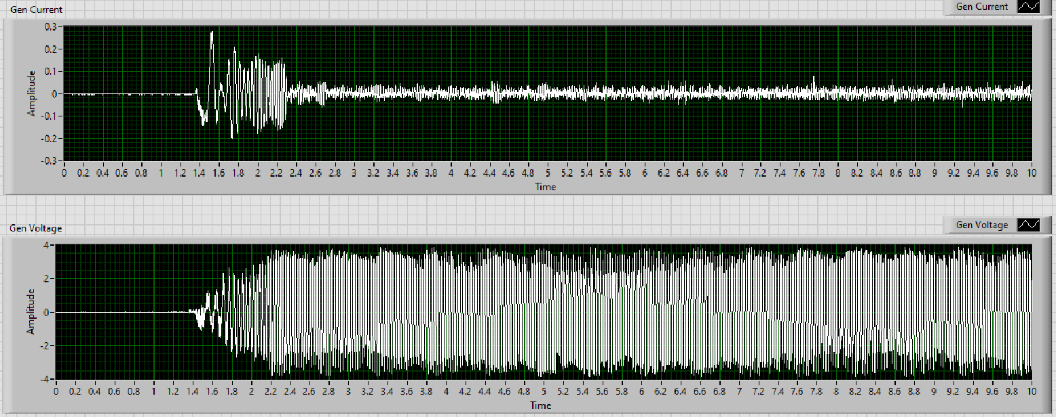
Example of 600rpm@Zero torque starting, after 3 sec, 2Nm torque pulse

Slide 11
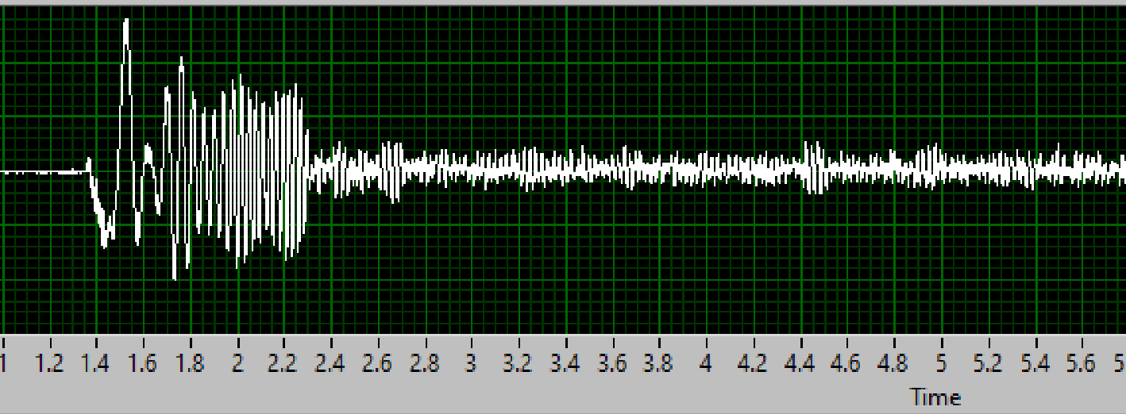

Slide 12
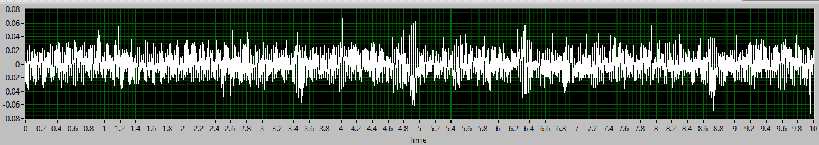
Example of constant 600rpm, 2Nm sequential torque pulses
10000 sample during 10 sec.

Slide 13
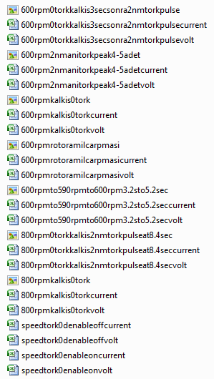
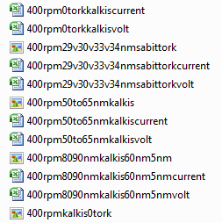
Measurements in excel table

Slide 14
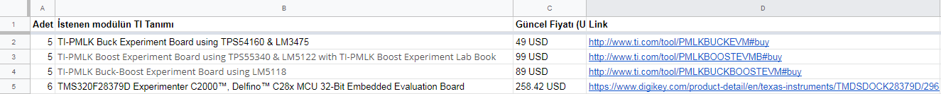
Next issues
Data analysis in MATLAB
Working on a detection method

